Slide 1
Artificial intelligence based multiscale failure analysis of advanced CFRP composite materials
Dr Lei Wan
l.wan@qub.ac.uk
School of Mechanical and Aerospace Engineering
Queen’s University Belfast, Belfast, UK
ISRC-CN3
25-29 October 2021

Slide 2
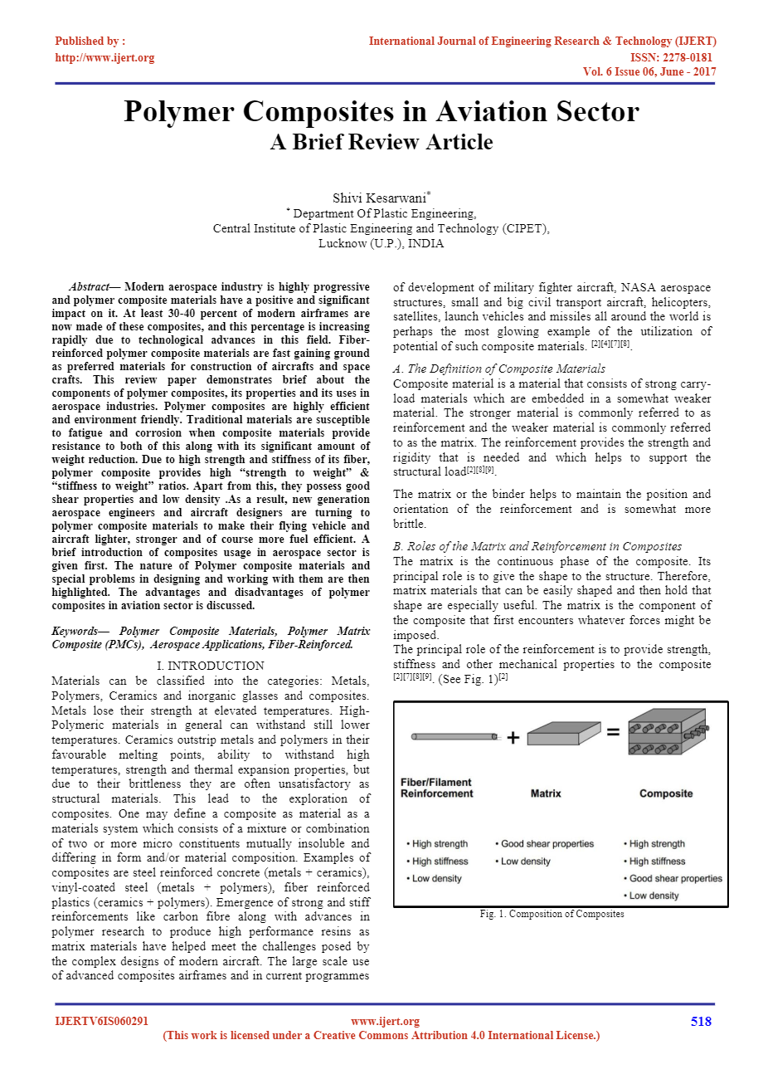
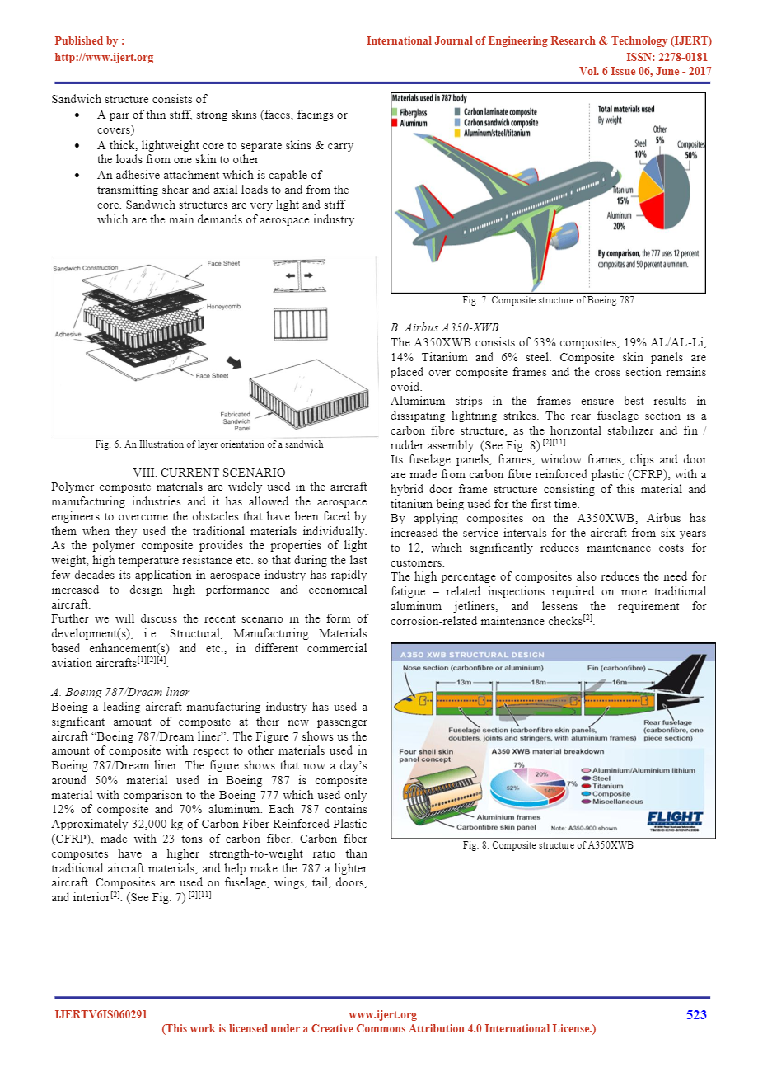
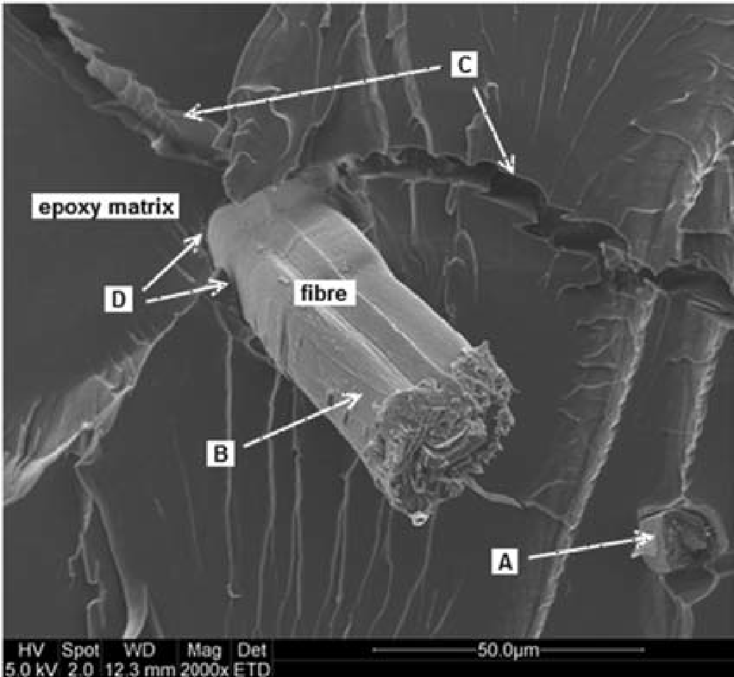
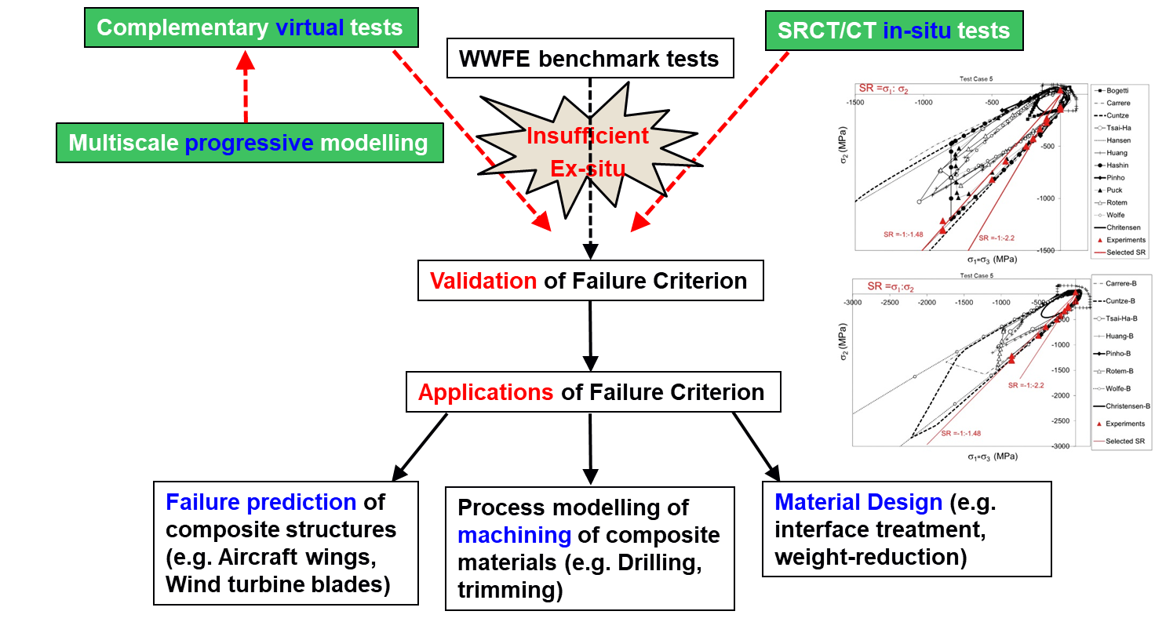
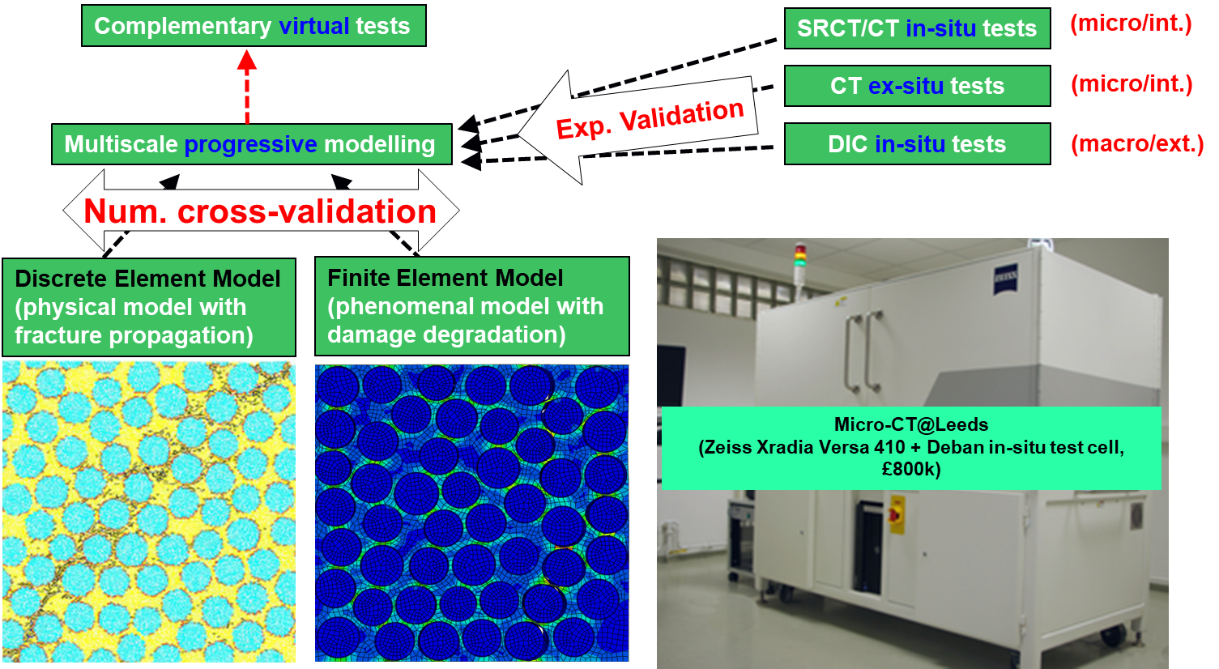
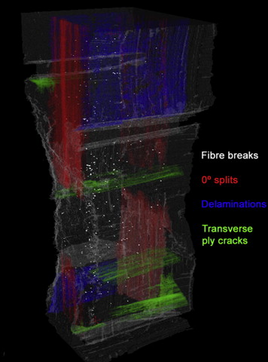
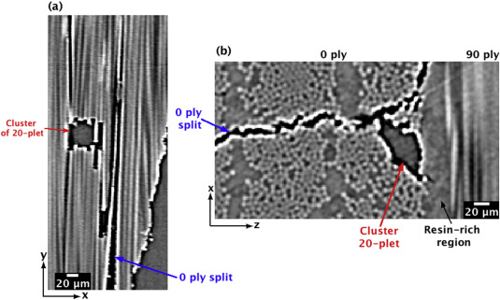
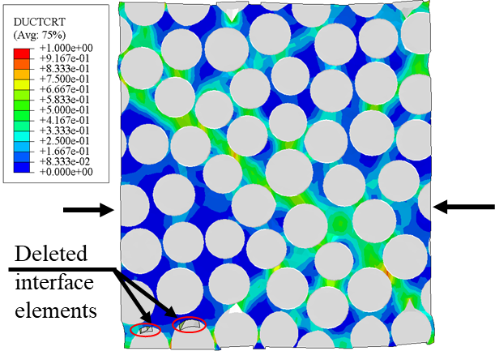
1. Research background
1.1 what are carbon fibre reinforced composites and what are they used for?
1.2 why should we study it?
Five different failure modes, coupling effects, etc. (A) Fibre pull-out, (B) fibre breakage, (C) matrix cracking and (D) debonding, delamination.
Progressive failure process difficult to predict, especially for mix damage modes.
1.3 how do we study it?
Experimental tests for failure criteria.
Numerical studies for progressive failure modelling.
Failure in Composite Materials & Structures:
(Micro-CT &SRCT
@Southampton)

Slide 3
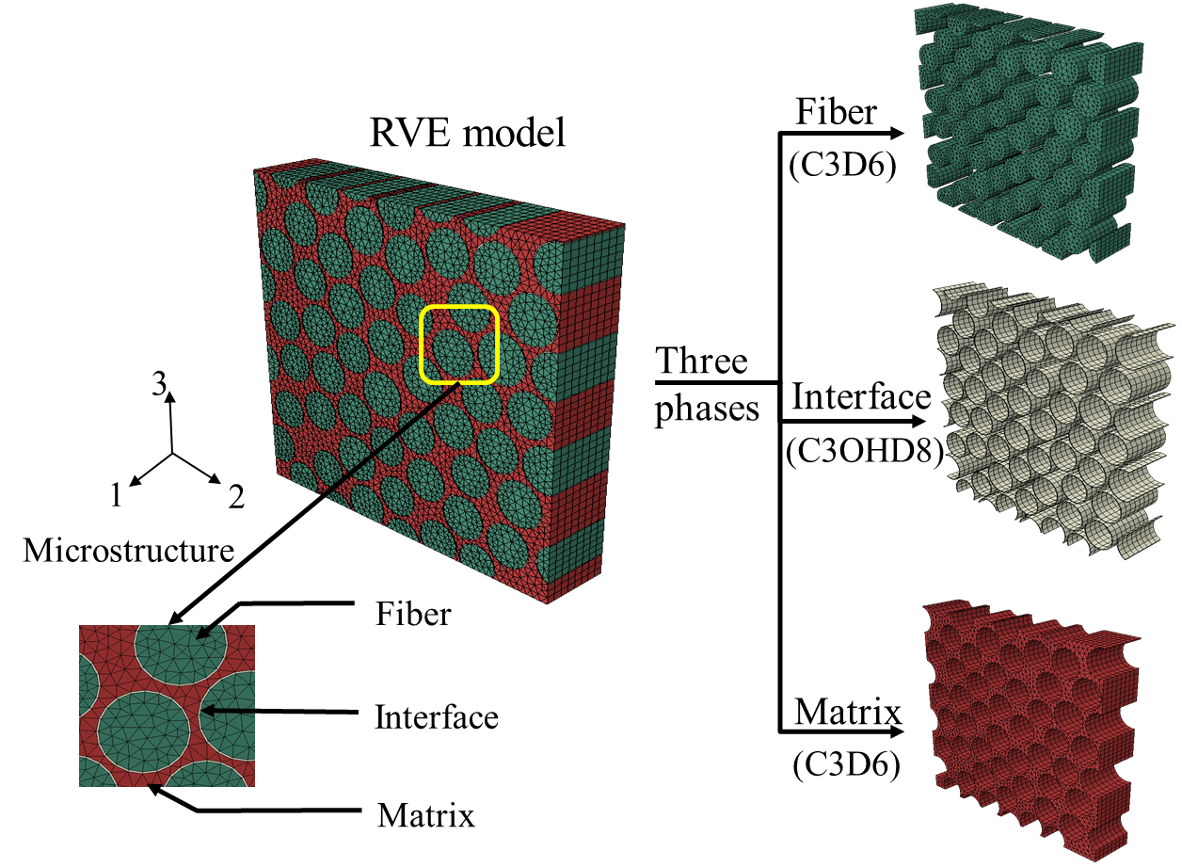
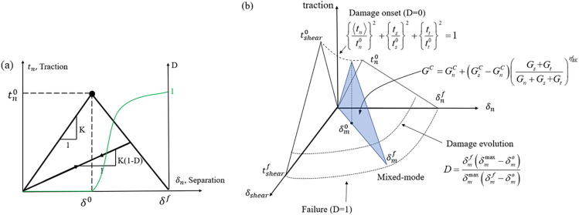
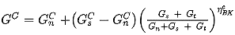
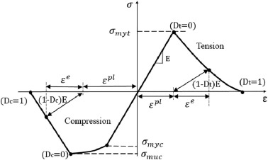
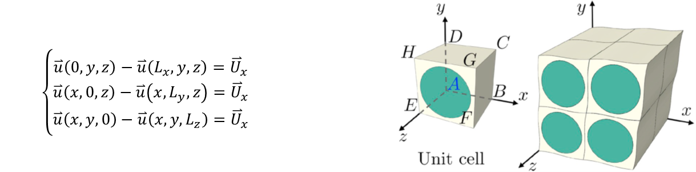
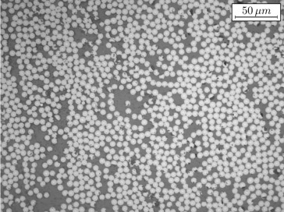
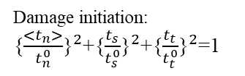
2. Micromechanics based failure analysis of composite lamina
2.1 3D FEM Representative Volume Element (RVE) model
Fiber is modelled as linear, elastic and transversely isotropic solids with Maximum stress failure criterion.
Damage initiation: {$\frac{<t_{n}>}{t_{n}^{0}}{\text{\}}}^{2}$+{$\frac{t_{s}}{t_{s}^{0}}{\text{\}}}^{2}$+{$\frac{t_{t}}{t_{t}^{0}}{\text{\}}}^{2}$=1
Damage propagation: Benzegath-Kenane (BK) criterion
Matrix is governed by Drucker-Prager yielding criterion. Damage of matrix is controlled by an internal damage initiation criterion and progressive failure model based on fracture energy.
Periodic boundary condition
Microstructure of UD composite lamina
Unified mathematical equations

Slide 4
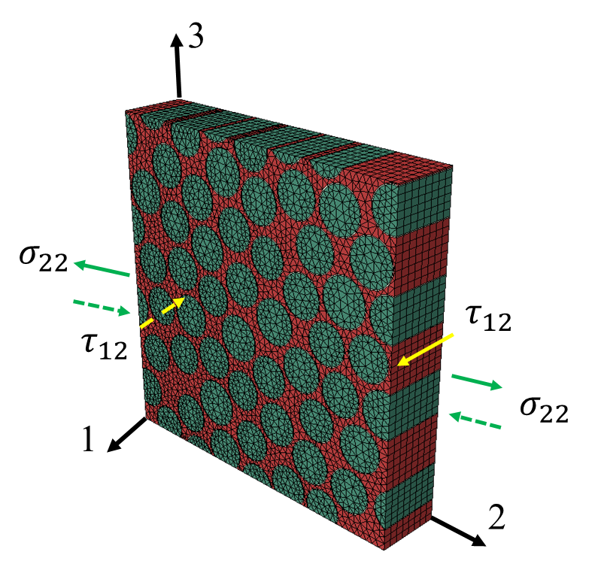
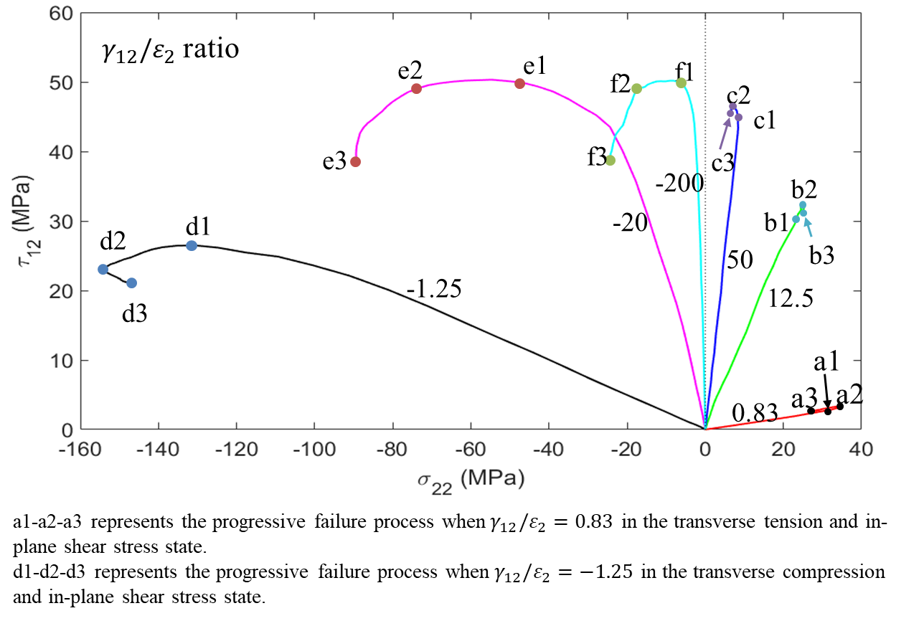
2.3 Progressive failure analysis of UD composite lamina under biaxial loadings
Failure envelopes of UD lamina under different biaxial loading conditions
Puck failure criterion
Tsai-Wu failure criterion
Hashin failure criterion
Comparison of failure criteria and numerical results obtained with a weak interface
Comparison of failure criteria and numerical results obtained with a strong interface

Slide 5
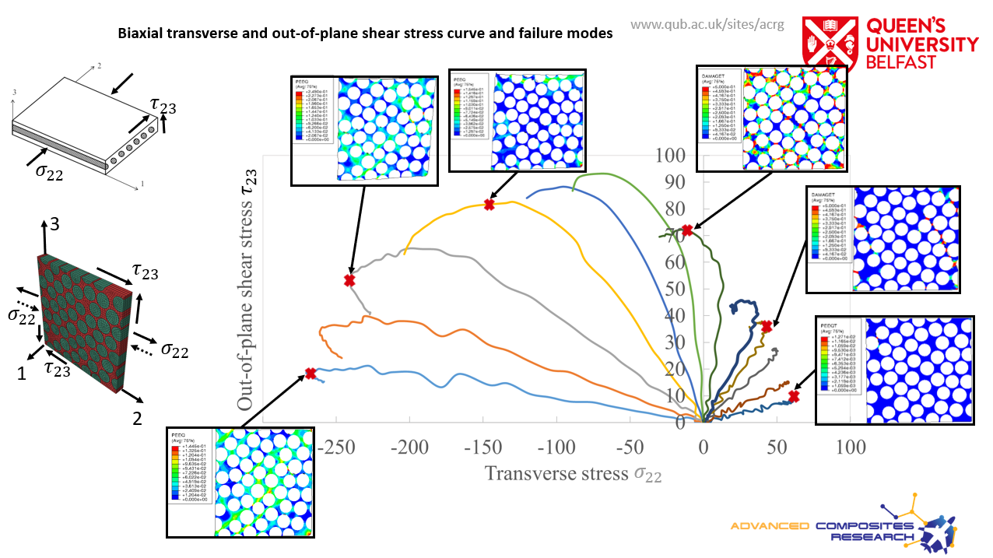
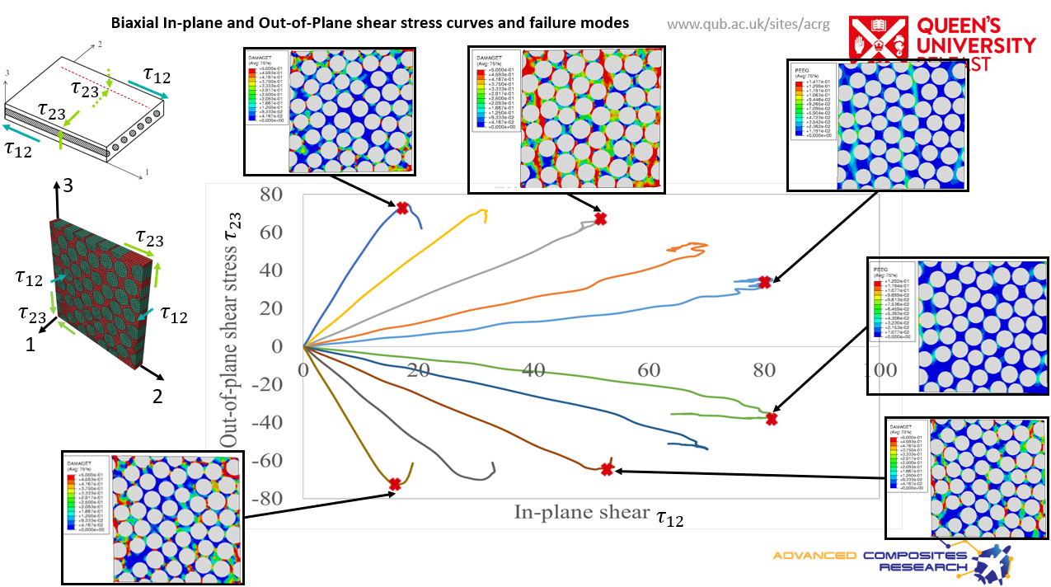
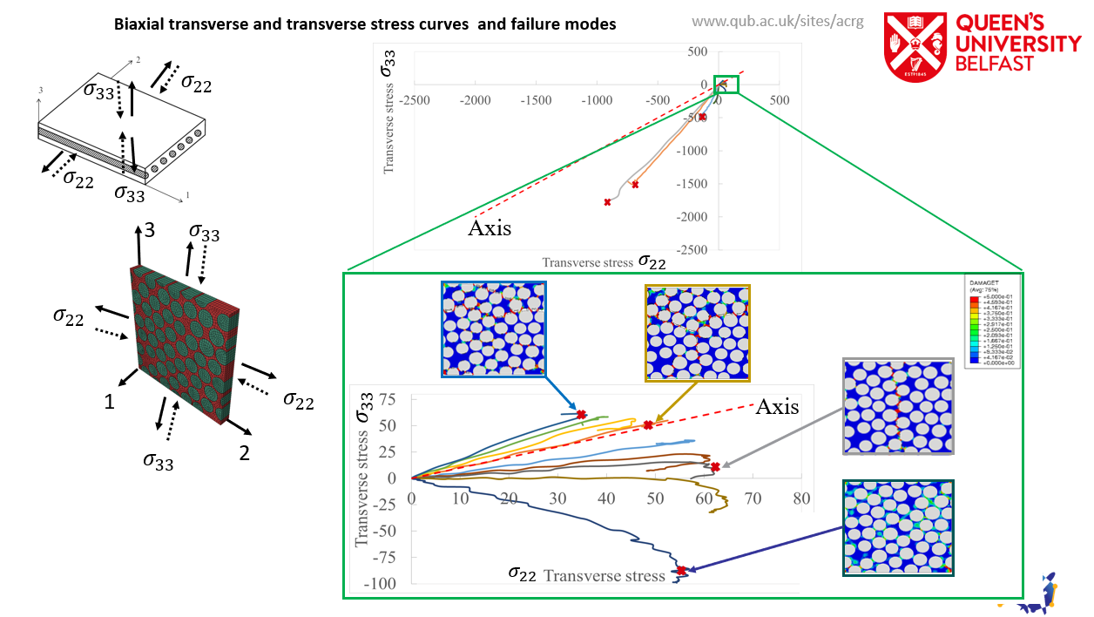
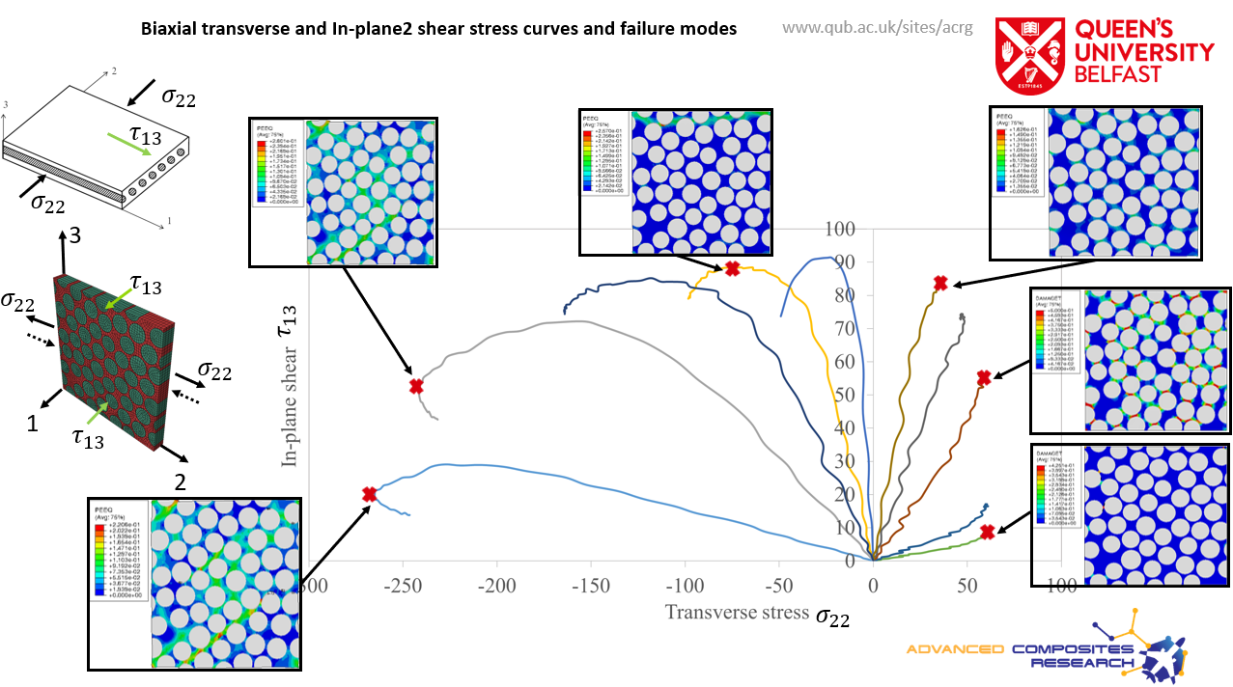
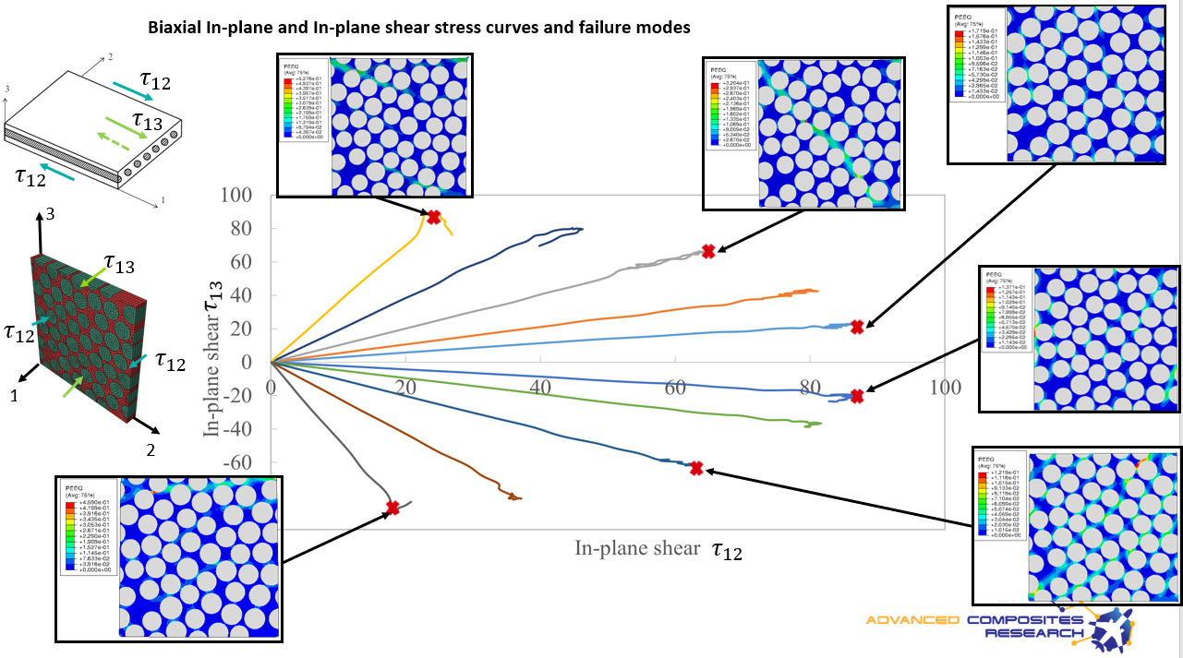

Slide 6
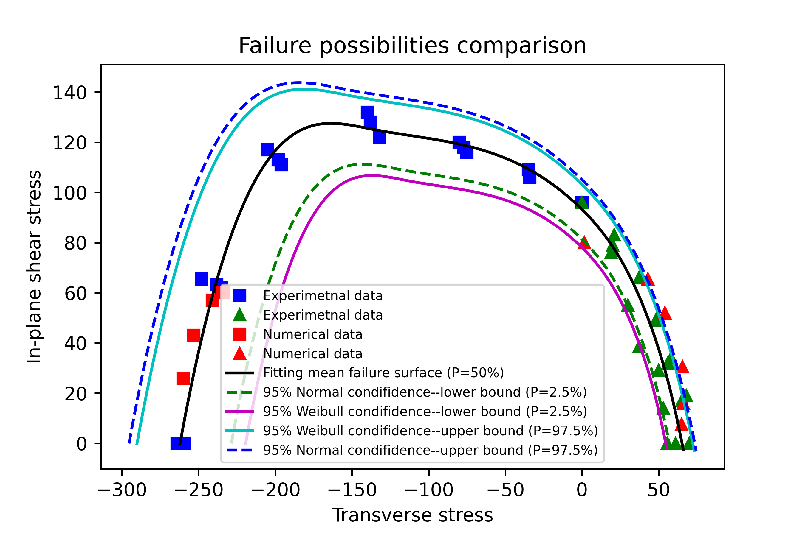
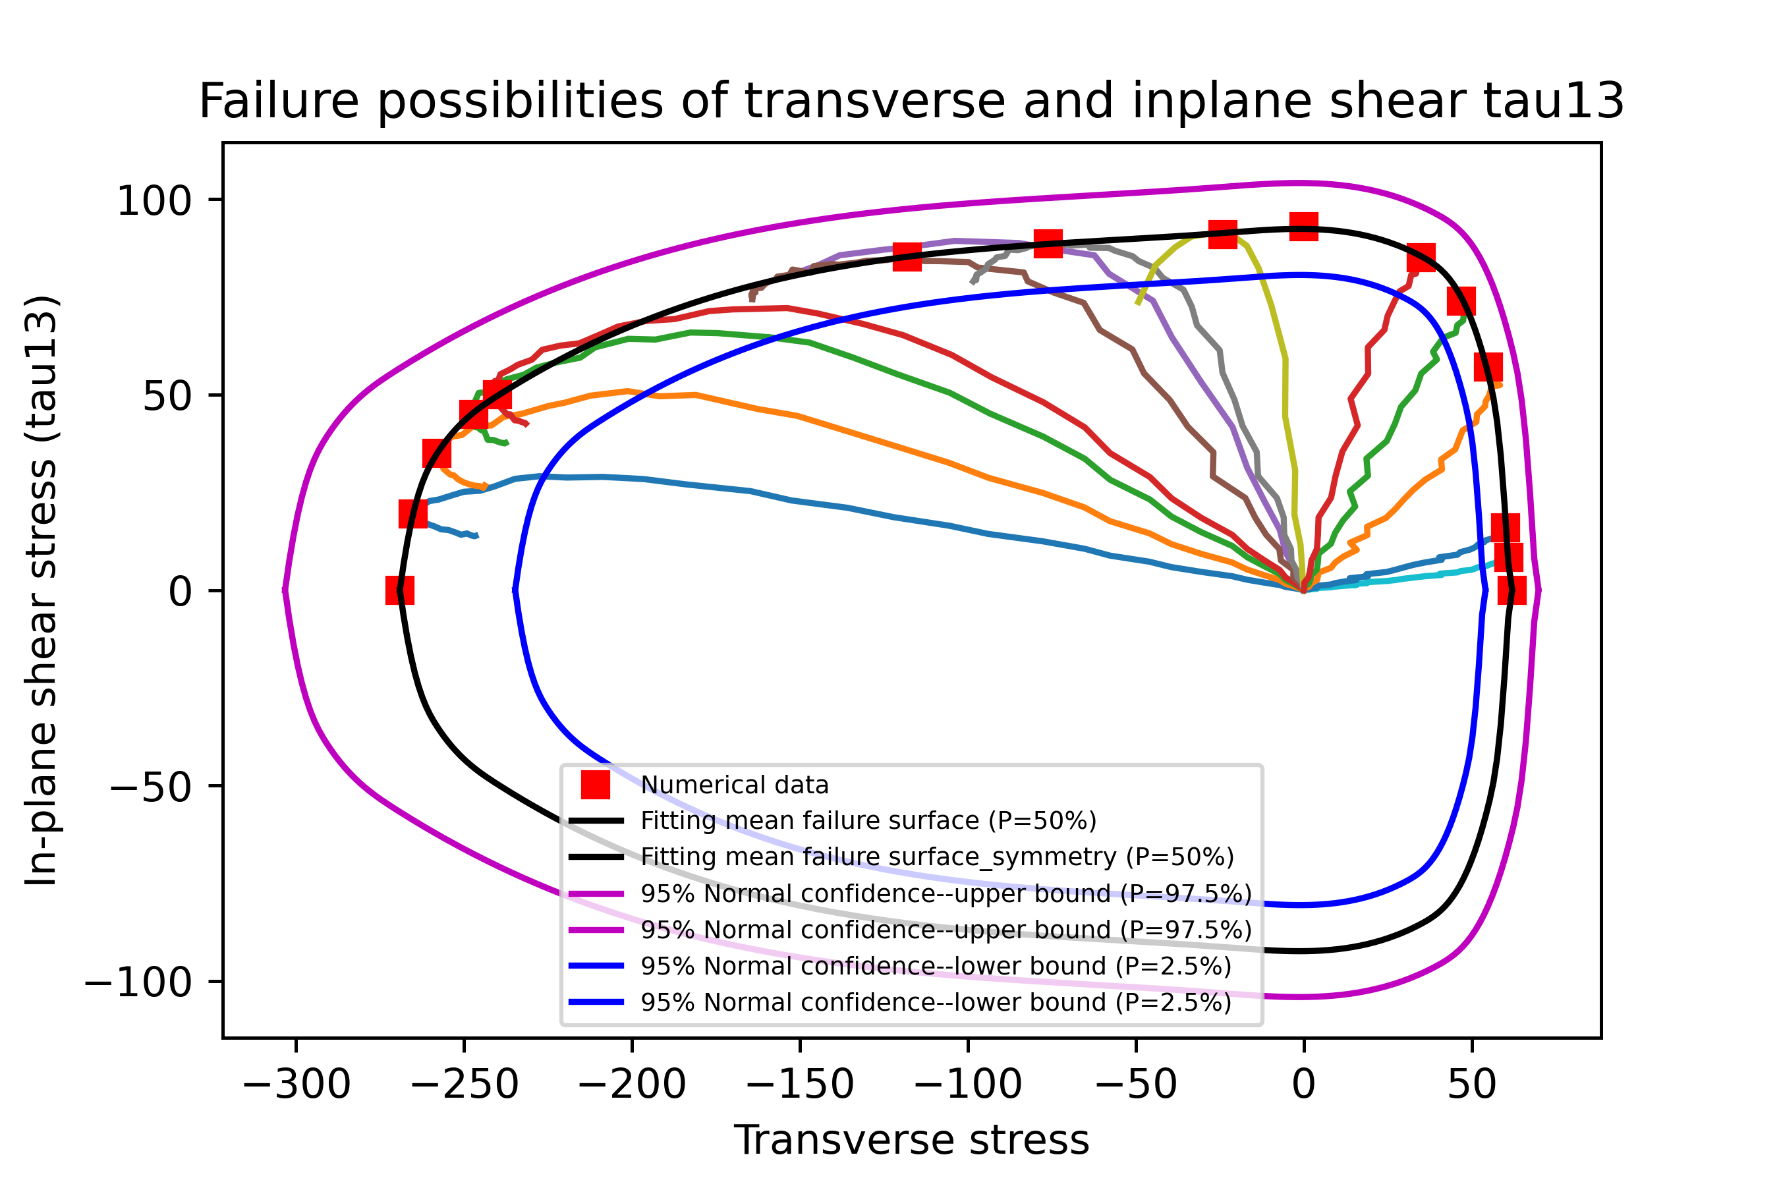
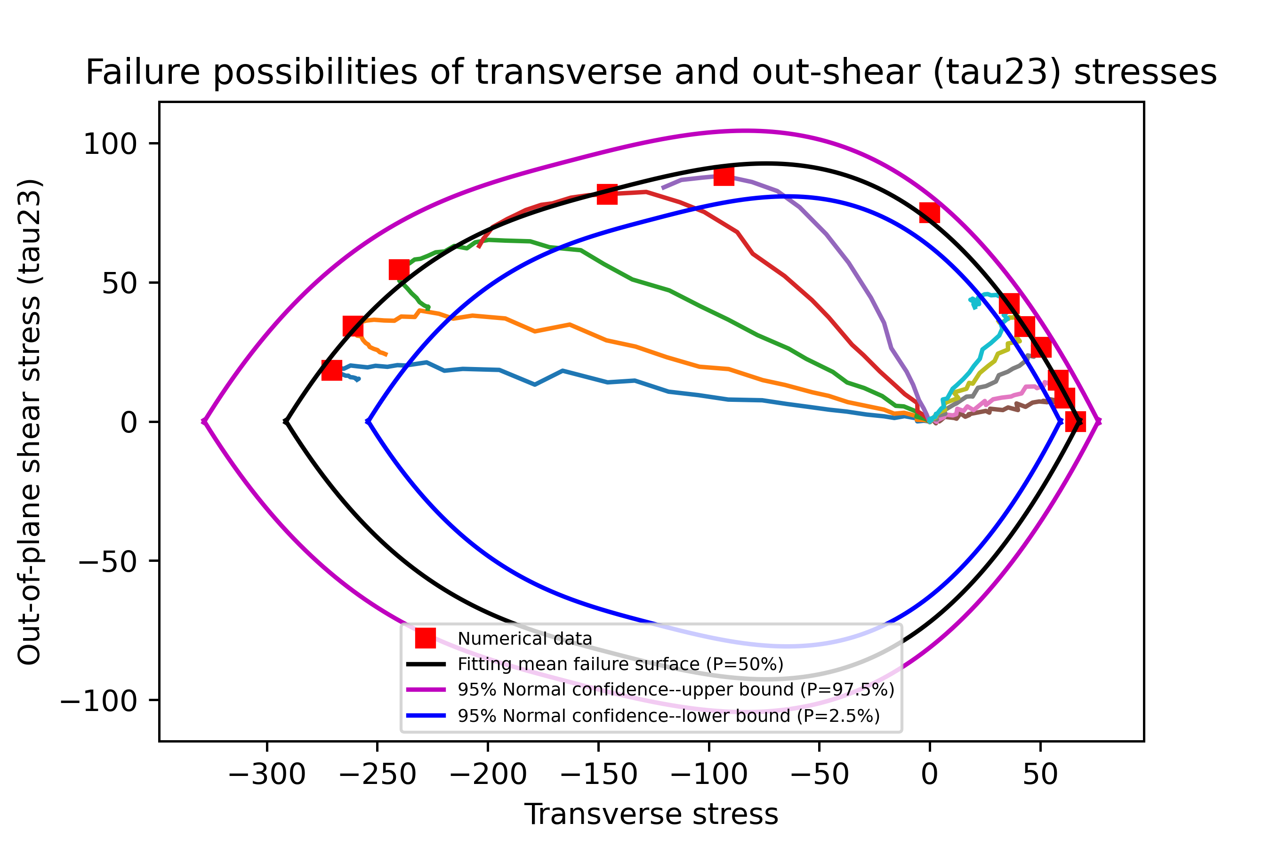
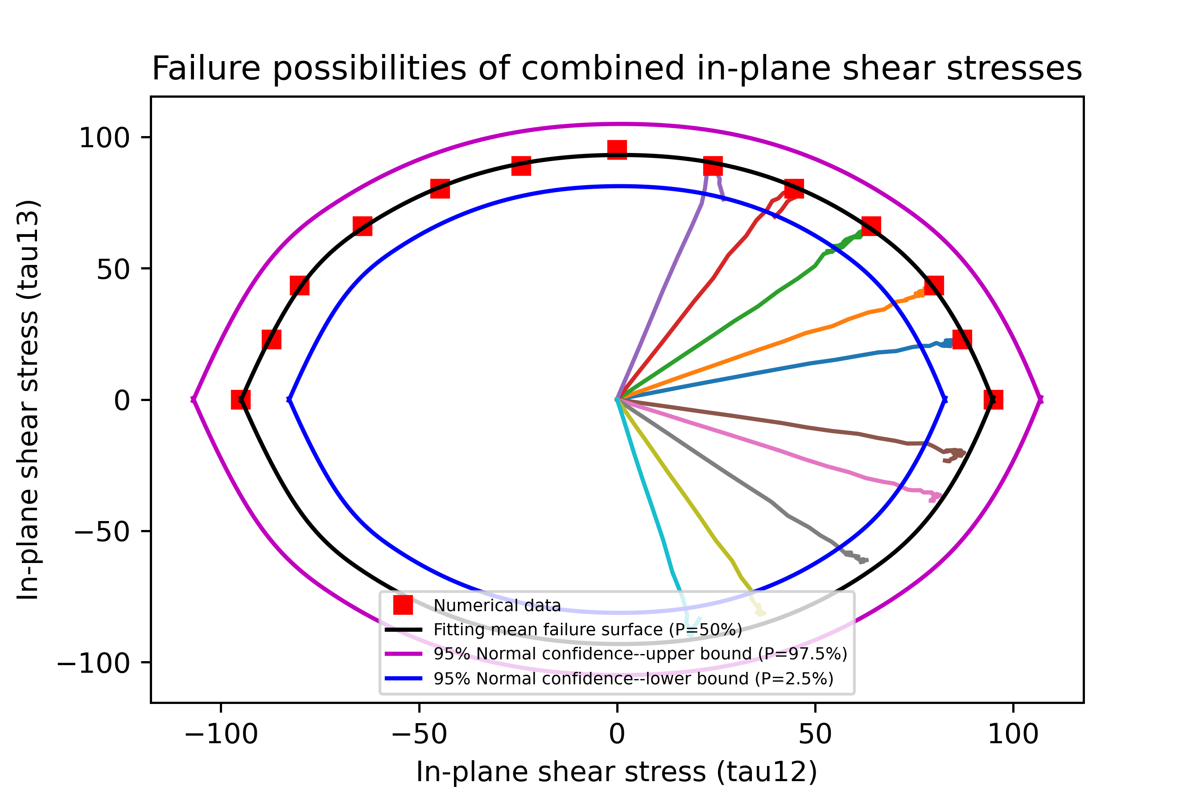
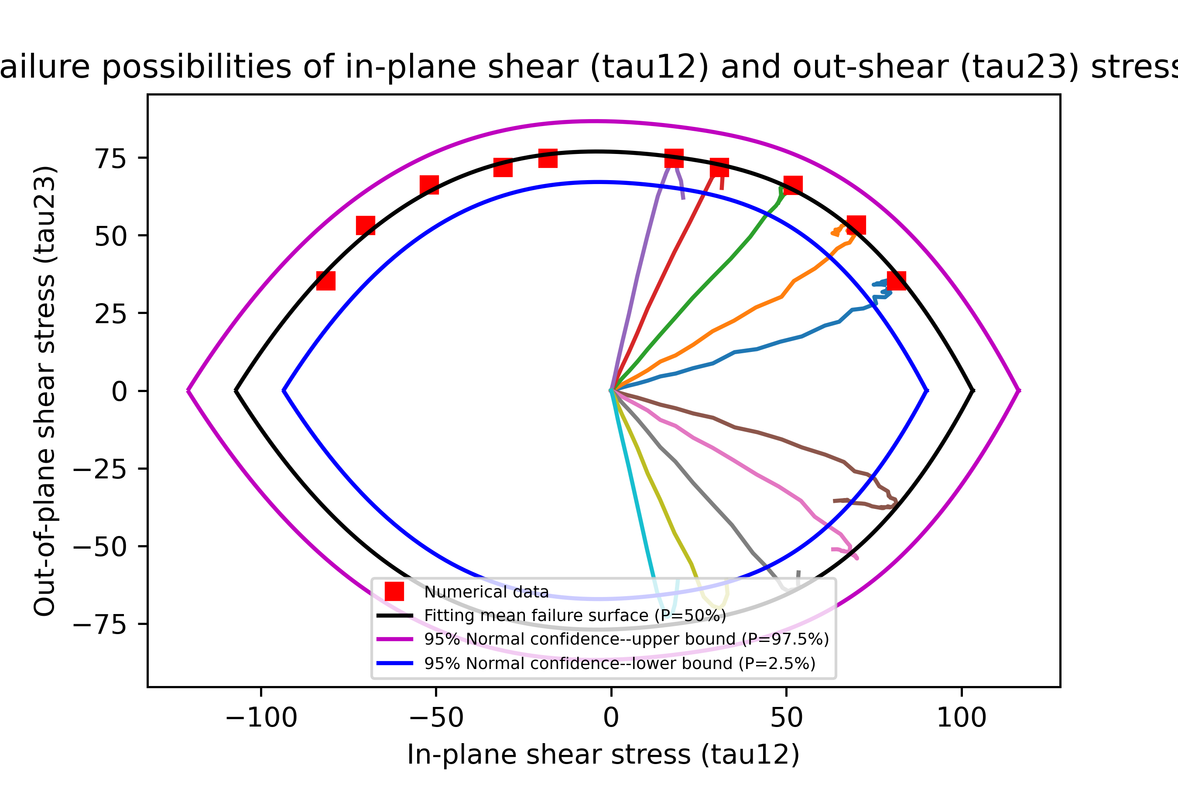
Biaxial loading cases data preparation for ANN training.
Experimentally validated numerical model for data generation (blue and green ones represent the experimental data, red ones represent numerical data);
Different curves represent different failure possibilities with a certain combination of stresses

Slide 7
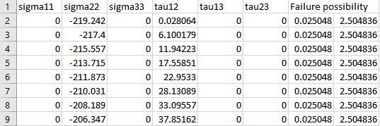
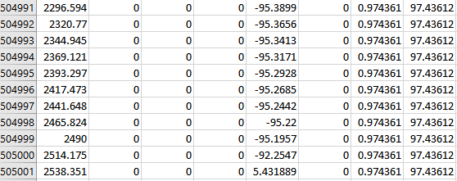
Artificial Neural Network
Training data (80%)
Datasets:
(505,000)
Inputs
Data preparation
Validation data (18%)
(3 mins)
Test data (2%)
ANN structure
P
Six stresses
Three layers: 16 neurons
Failure possibility
Output

Slide 8
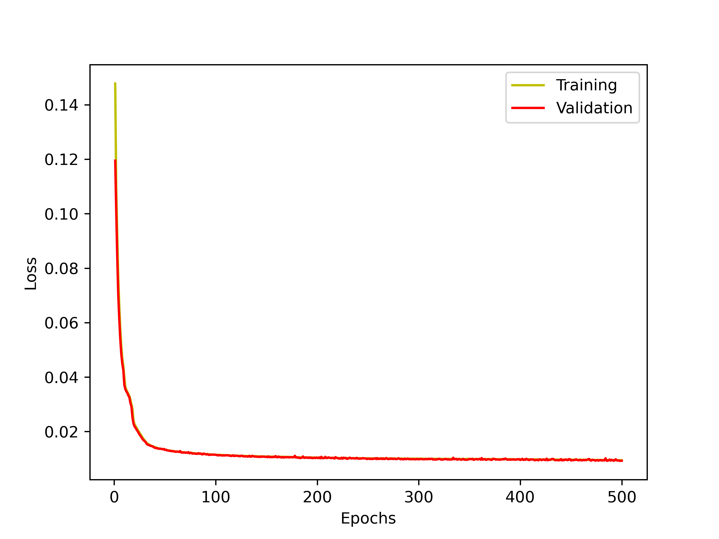
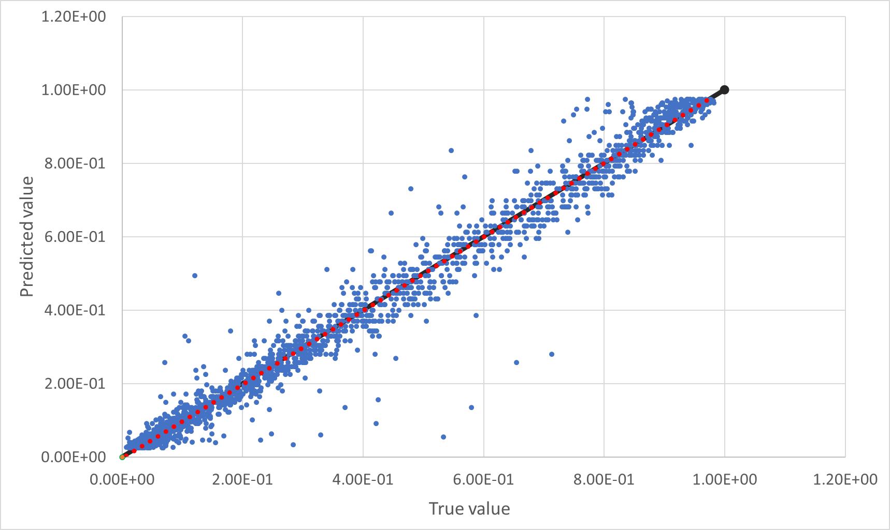
Artificial Neural Network-results
Loss-epoch curves for training and validation (batch size=1000, epochs=500)
Comparison between 2000 test and prediction datasets
X=Y
Fitting line
becomes stable
 | Batch size | epochs | Loss_training (MSE) | Loss_Val (MSE) | Pre_MSE (RMSE)
6-32-32-32-1 | 500 | 300 | 0.005 (0.0018) | 0.0052 (0.0021) | 0.0019 (0.0439)
6-32-32-32-1 | 1000 | 300 | 0.0049 (0.0018) | 0.0049 (0.0018) | 0.00174 (0.0417)
6-32-32-32-1 | 2000 | 300 | 0.005 (0.0019) | 0.0051 (0.002) | 0.00169 (0.0411)
6-128-128-128-128-1 | 1000 | 300 | 0.004 (0.0011) | 0.0041 (0.0012) | 0.00109 (0.033)
Loss becomes stable after 250 epochs;
Batch size has limited influence on the loss of training and validation process;
ANN architecture has large influence on the prediction results
Fitting line from the prediction data matches X=Y very well

Slide 9
Thanks for your attention.

